Slide 1
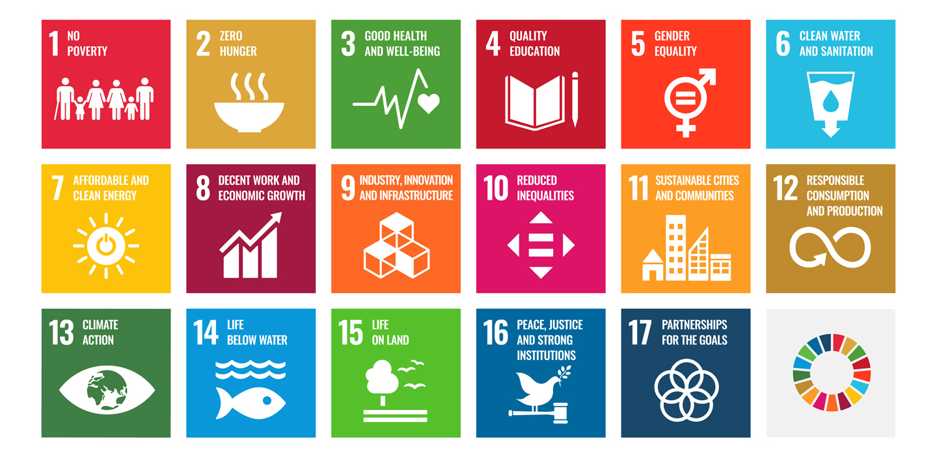
BRINGING THE 2030 SUSTAINABLE DEVELOPMENT GOALS TO THE AV INDUSTRY
USAV 2022 Spring Conference Presentation
Notes:
(Slide 1) (Christina) Introduction Slide

Slide 2
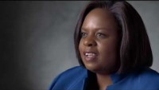
Notes:
(Slide 2) (Christina) Video

Slide 3
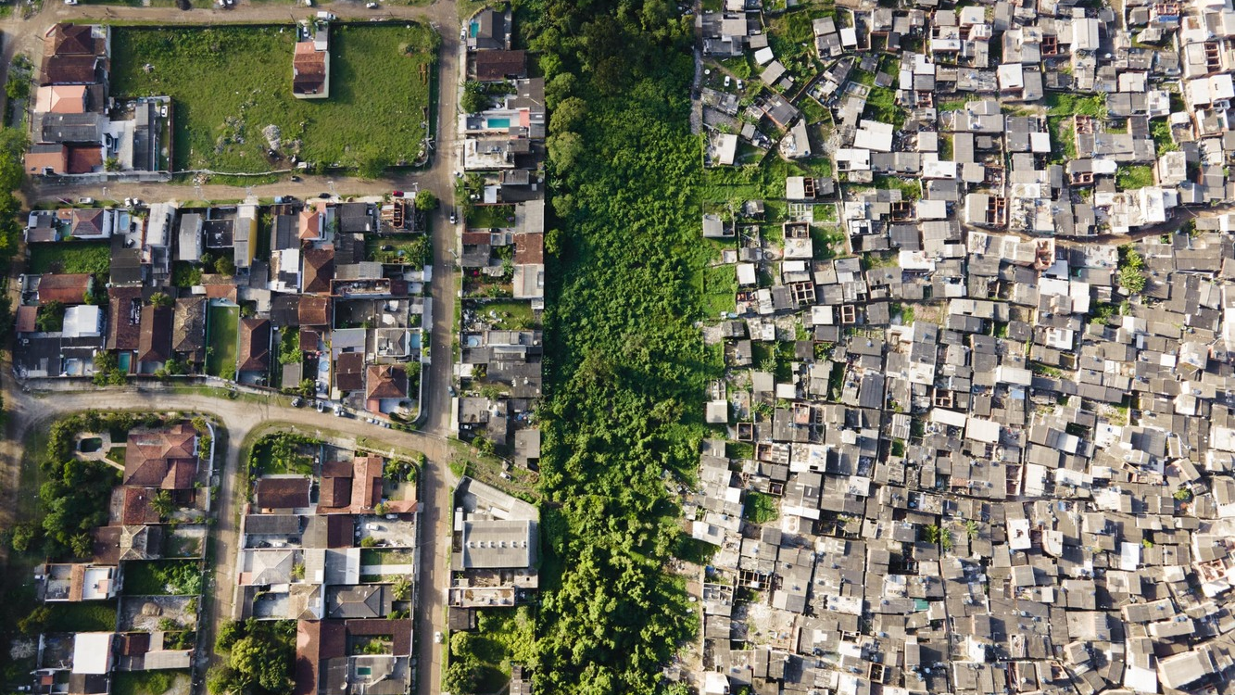

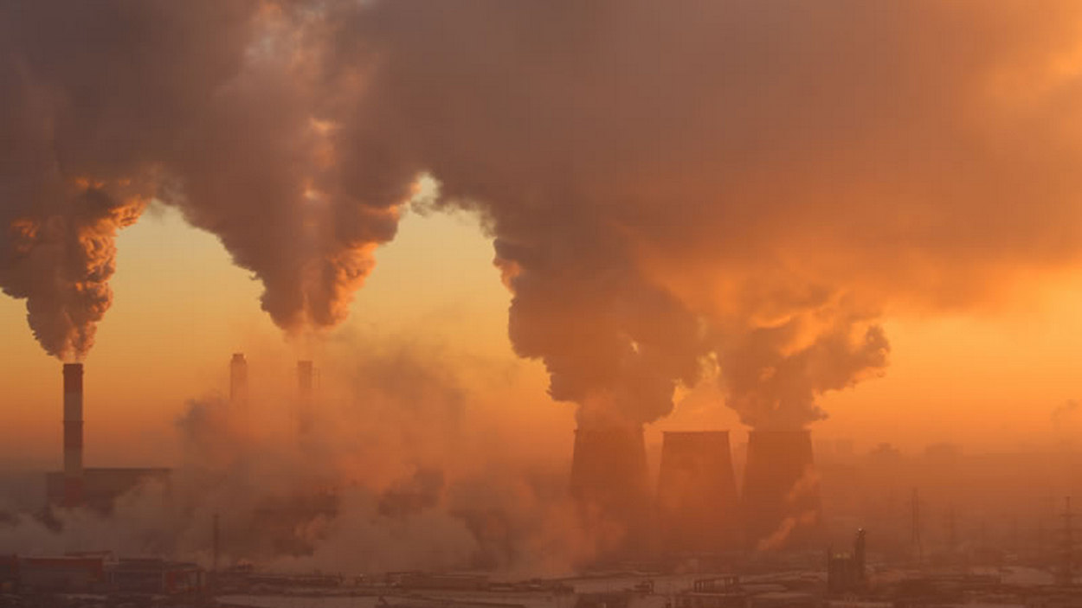
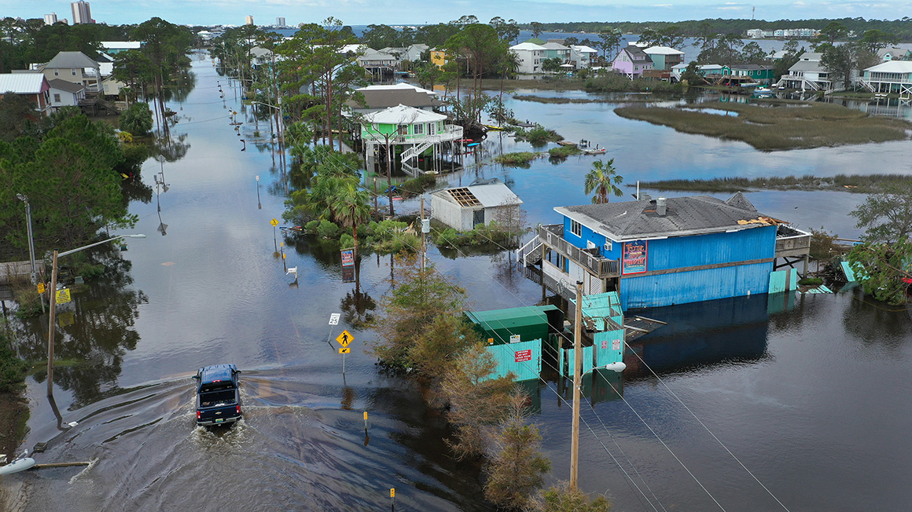
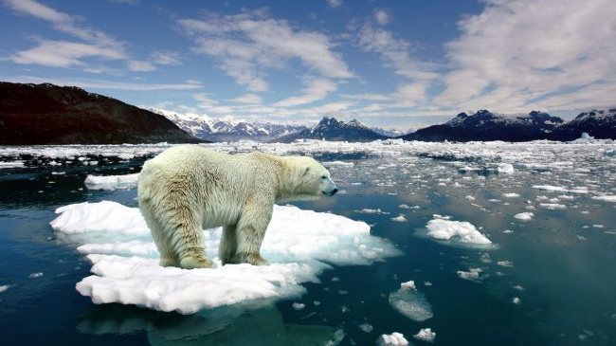
THE PROBLEM
Poverty and Inequality
Environmental Degradation
Accelerating Threats to Sustainability
Climate Change
Notes:
Start right after the video: Christina will start by saying, “From climate change and environmental degradation to poverty and inequality, our businesses, communities, and our very planet face serious and accelerating threats to sustainability, and survival.”

Slide 4
What is the role of our industry in solving the climate crisis and achieving sustainable development?
Notes:
Start when Joe speaks after Christina. Joe will say, “What is the role of our industry in solving the climate crisis and achieving sustainable development?”

Slide 5

How much e-waste do you think North America and Europe generated in 2019?
ⓘ Start presenting to display the poll results on this slide.
Notes:
Start slide when Joe ends with, “Are there alternate materials that could be used in the manufacturing of AV equipment that are eco-friendly or can more easily be recycled? Who is going to motor these changes?”

Slide 6
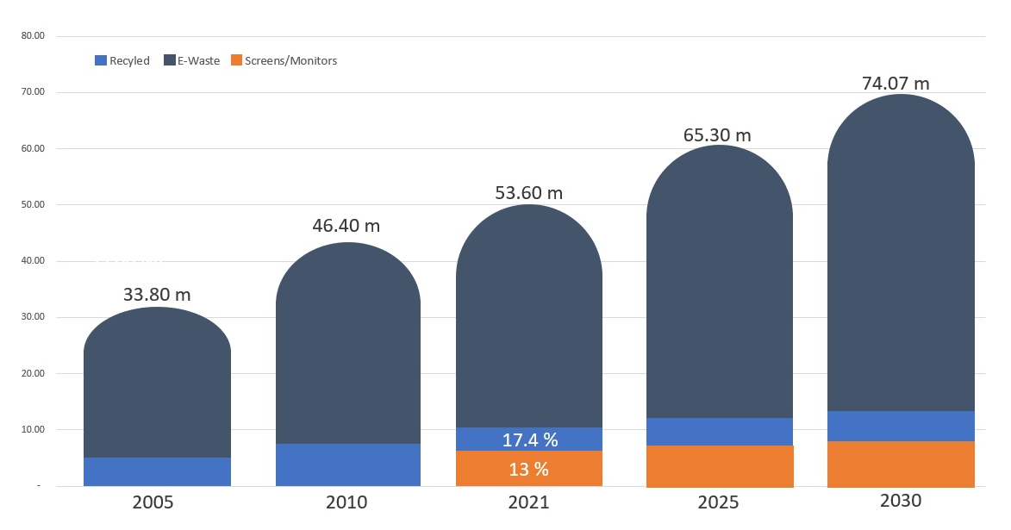
Global E-waste Generated by Year
in million tons
The Global E-waste Monitor 2020, UNU/UNITAR SCYCLE©/Nienke Haccoû
In 2019 alone, over 50 million tons of e-waste - including displays, cables, power supplies and other AV equipment, were generated in North America and Europe.
Notes:
Starts when poll is complete. Joe will start with, “According to the Center for Sustainable Enterprise’s ‘Sustainability in the Supply Chain’ study, “In 2019 alone, over 50 million tons of e-waste, including displays, cables, power supplies and other AV equipment, were generated in North America and Europe.”

Slide 7
What percentage of used electronics are recycled?
ⓘ Start presenting to display the poll results on this slide.
Notes:
Start when Joe ends with, “Companies are not creating products with the intention of them lasting forever but instead, they plan for them to break in order for the customer to spend more money by buying a replacement.”

Slide 8

In 2019, less than 20% of used electronics were formally recycled.
Notes:
Start when poll is complete. Joe will start with, “In 2019, less than 20% of used electronics were formally recycled. Not only is this waste bad for the environment, but it is also dangerous to the communities in which these gadgets are left as they contain harmful materials such as mercury, lead, and cadmium (UN E-Waste Report 2019).”

Slide 9
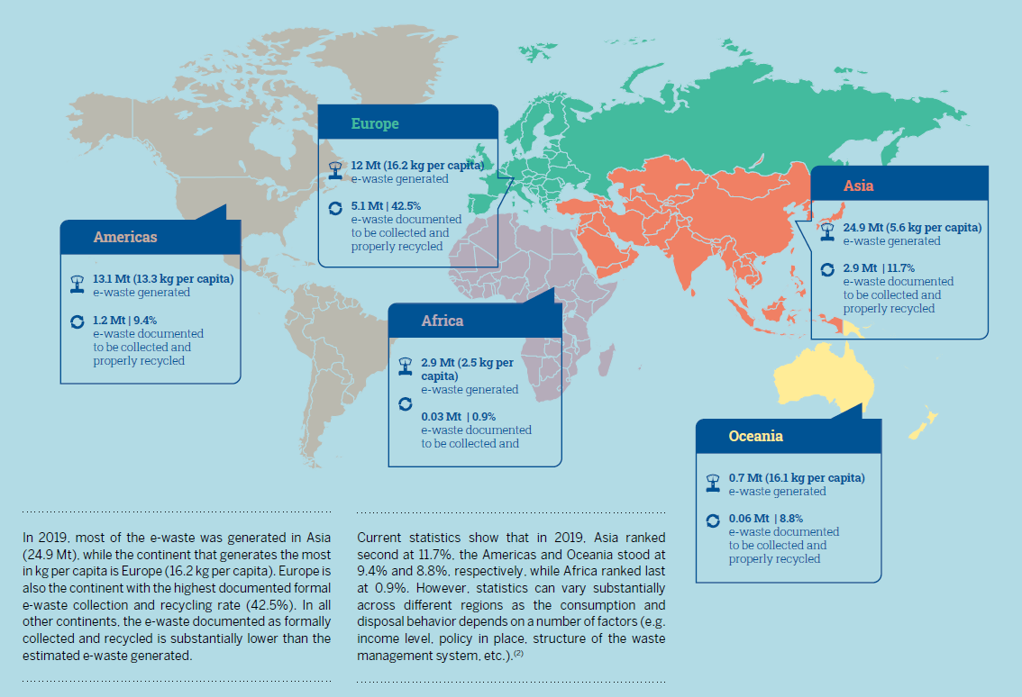
The Global E-waste Monitor 2020, UNU/UNITAR SCYCLE©/Nienke Haccoû
Notes:
Start when Joe says, “Here is the breakdown of global e-waste per region according to The Global e-waste Monitor report in 2020.”

Slide 10

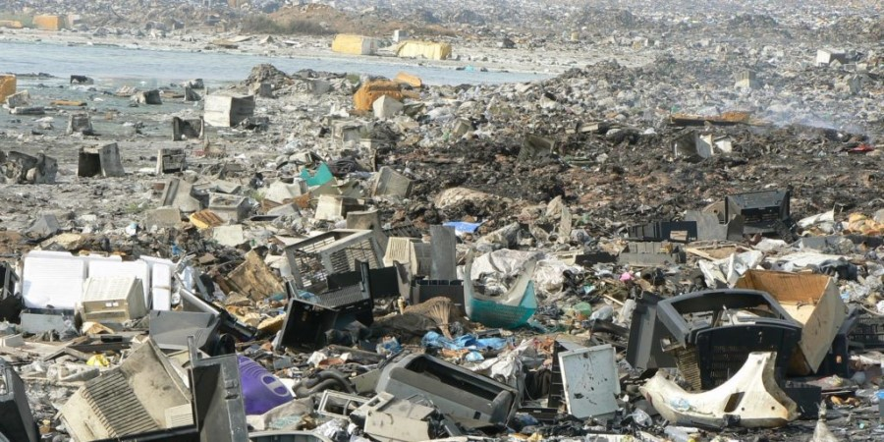
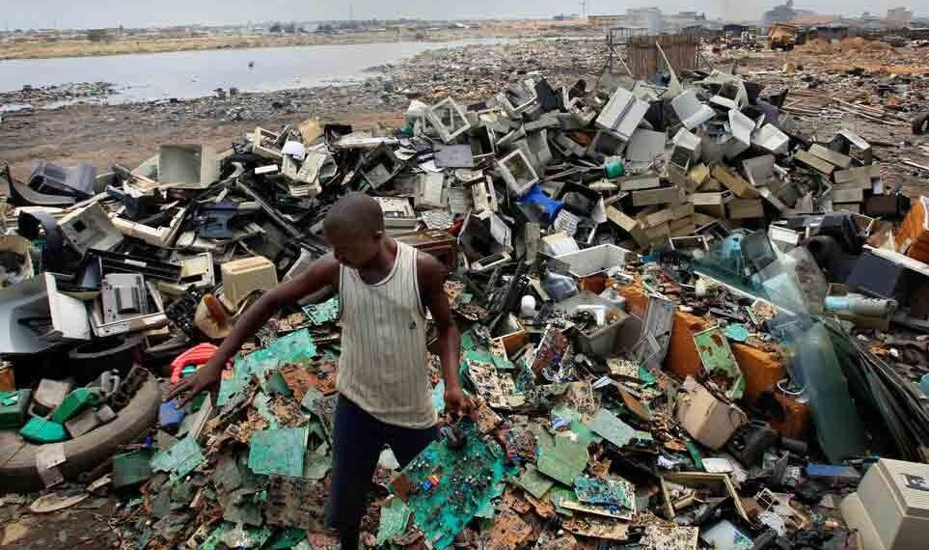
Accra,
Ghana
Notes:
Start when Joe says, “Accra, Ghana is considered to be the largest e-waste landfill in the world.”

Slide 11
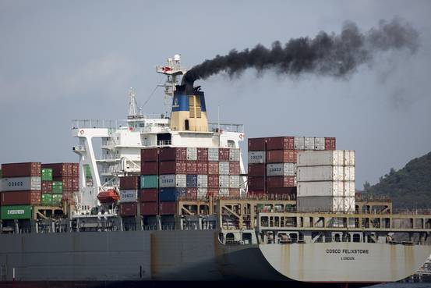

About 26% of total U.S. energy consumption in 2020 was for transporting people and goods from one place to another.
Share of total U.S. energy used for transportation, 2020
Notes:
Start when Joe says, “There are other ways the AV industry has an impact on the sustainability of our planet and the people.”

Slide 12
According to the Wall Street Journal, in just the next decade, there will be upwards of $12 trillion in business opportunities for companies that align themselves with sustainable development.
Notes:
Start when Joe says, “There is increasing evidence that the AV and low voltage industries’ customers and employees want to be associated with businesses focused on sustainability.”

Slide 13
“Sustainable Development”
In 1987, the countries of the world officially defined the term “Sustainable Development” to mean “meeting the needs of the present without compromising the ability of future generations to meet their own needs.”
Notes:
Start when Christina says, “In 1987, the countries of the world officially defined the term “Sustainable Development” to mean “meeting the needs of the present without compromising the ability of future generations to meet their own needs.”

Slide 14

Notes:
Start when Christina says, “In September 2015, the 2030 Agenda for Sustainable Development was adopted by all 193 member nations of the UN, including the United States, in a unanimous vote, each one pledging to achieve these indivisible and universal goals in each nation by 2030 in order to ensure a sustainable world for all people.”

Slide 15
The Pro AV industry alone is expected to generate $259 billion in 2022
$
$
$
Notes:
Start when Joe says, “The PRO AV and low voltage industries encompass a vast range of businesses that include systems contractors/integrators, product manufacturers, consultants, programmers, engineers, technicians, and other allied professionals.”

Slide 16

Electronics are central to work and social life in developed nations. If we were able to create a circular economy in this industry, we can save upwards of 54 million tons of waste per year.
Notes:
Start when Joe says, “Goal 12 of the SDGs focuses on responsible manufacturing, as well as reuse, repurposing, recycling, and reduction at every stage of the product life cycle, beginning with how materials are sourced for manufacturing, and concluding with how we dispose of the products at the end of their useful life.”

Slide 17

SAVe, is the first industrywide US based organization to bring stakeholders together to take concerted action to achieve the 2030 Sustainable Development Goals.
Notes:
Start when Christina says, “It’s not enough for private companies to merely endorse these goals.”

Slide 18

Get “SAVe Certified” – SAVe will provide a certification program for companies in the AV industry.
Notes:
Start when Christina says, “Get “SAVe Certified” – SAVe will provide a certification program for companies in the AV industry.”

Slide 19

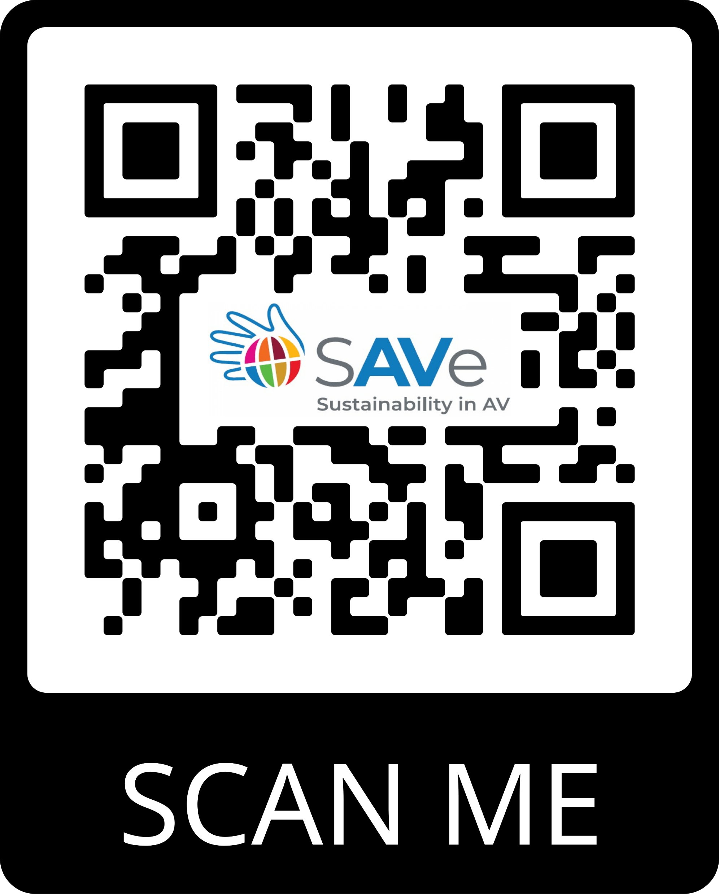
Download ClearTech’s SDG sustainability
Notes:
Start when Christina says, “To learn more and/or get involved with SAVe, please let us know after the presentation.”

Slide 20

JOIN US FOR OUR WORKSHOP
“Bringing the SDGs to your company -how to get started”
Notes:
Start when Christina says, “I hope that you can join us for our workshop at about “Bringing the SDGs to your company -how to get started” where we will explore ways that you take meaningful action now towards achieving these goals that are critical for not only the health of our industry but the future of our planet.”

