Slide 1
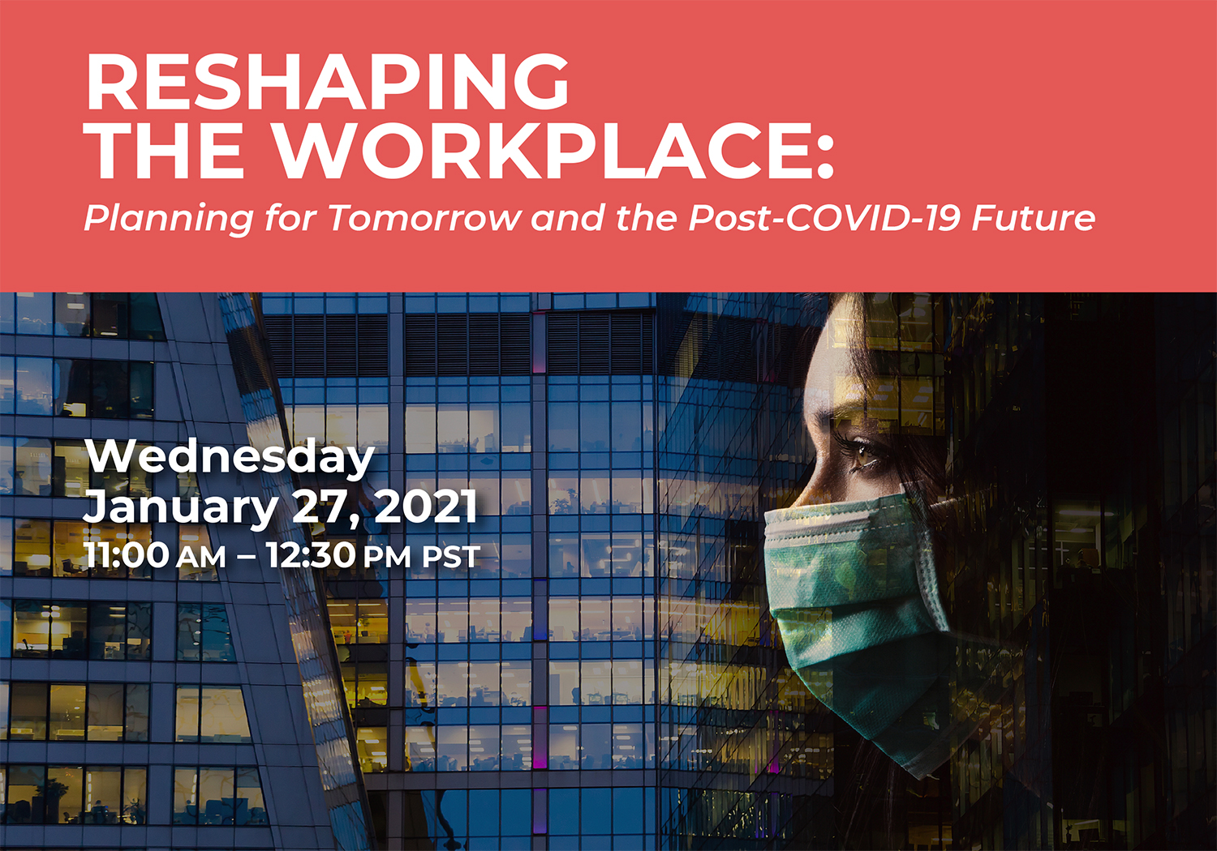


Slide 2
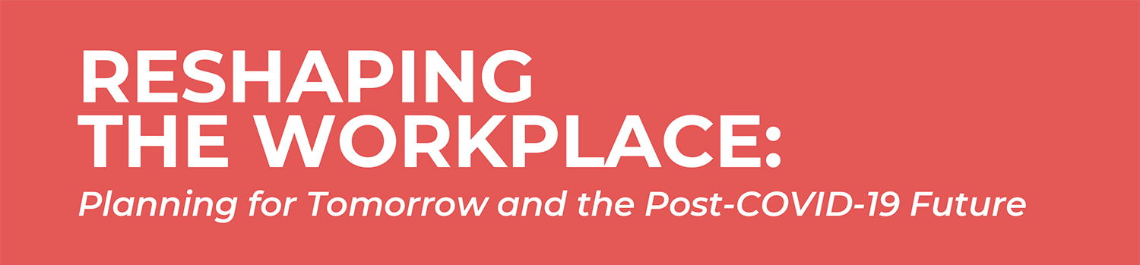
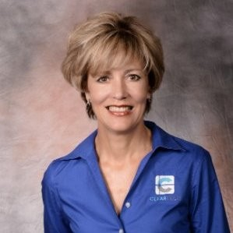
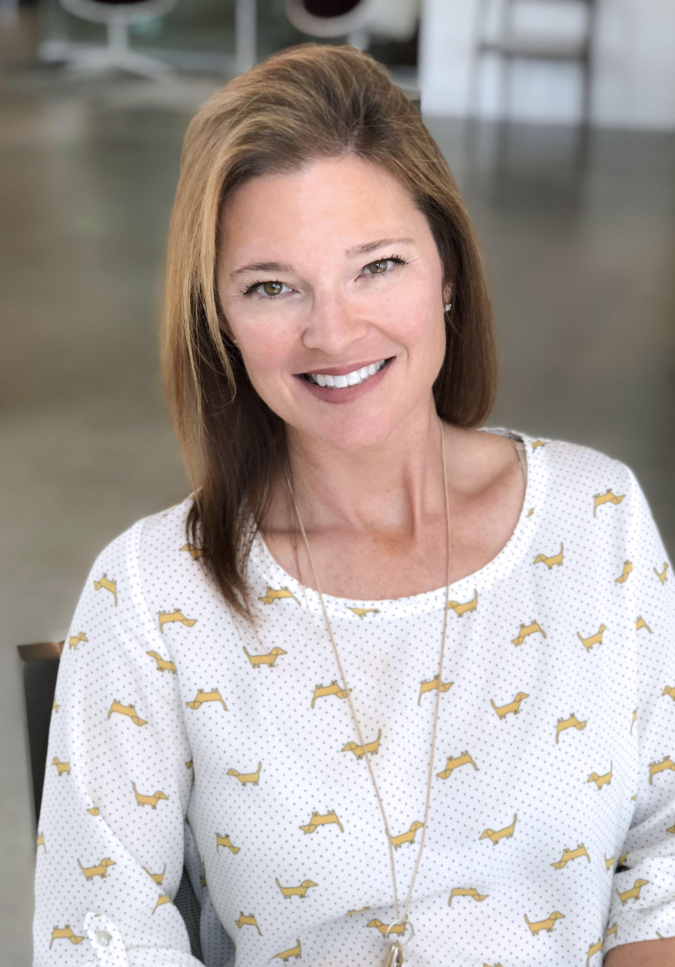
IFMA WE SO CAL LEADERS
Christina De Bono
President, ClearTech
Holly Rau
Managing Director, PeopleSpace

Slide 3




MEET OUR HOSTS

Slide 4
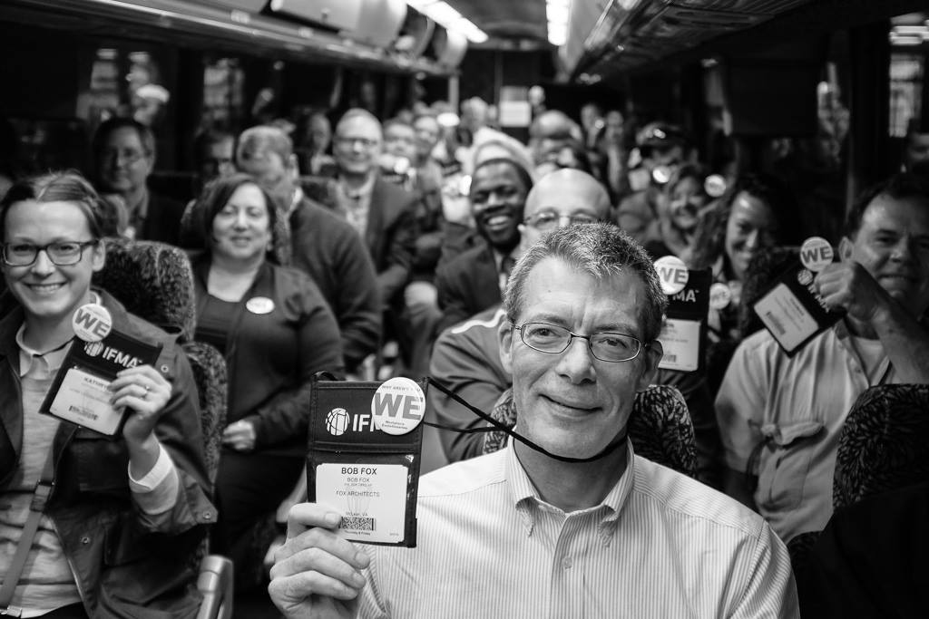
Our Mission
To co-create workplace knowledge that will enhance workforce collaboration, productivity and experience.
We will achieve this by bringing together members and thought leaders globally to share new ideas and research which will evolve the profession of workplace worldwide.

Slide 5
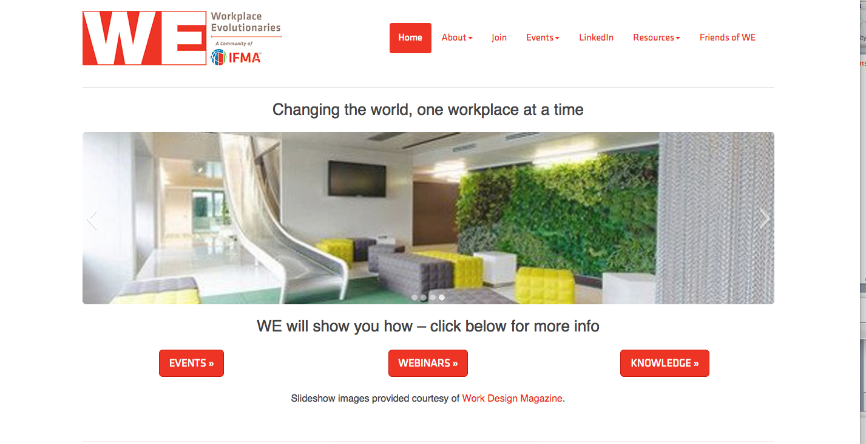

Check out our Website to learn more
www.we.ifma.org

Slide 6
Resource Materials
ClearTech E-book – Stop Guessing and Start Planning: How Technology Will Unite Us in the Distanced Future
IFMA Foundation - IFMA Foundation Pandemic Manual
JLL – Reimagine, The New Future of Work to Shape a Better World
PeopleSpace – Bluescape Library of Workplace Reentry Strategies

Slide 7
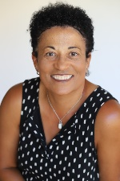
IFMA Foundation
Diane Coles Levine
Irene Thomas-Johnson
Board Member at IFMA Foundation
JLL Executive Director

Slide 8
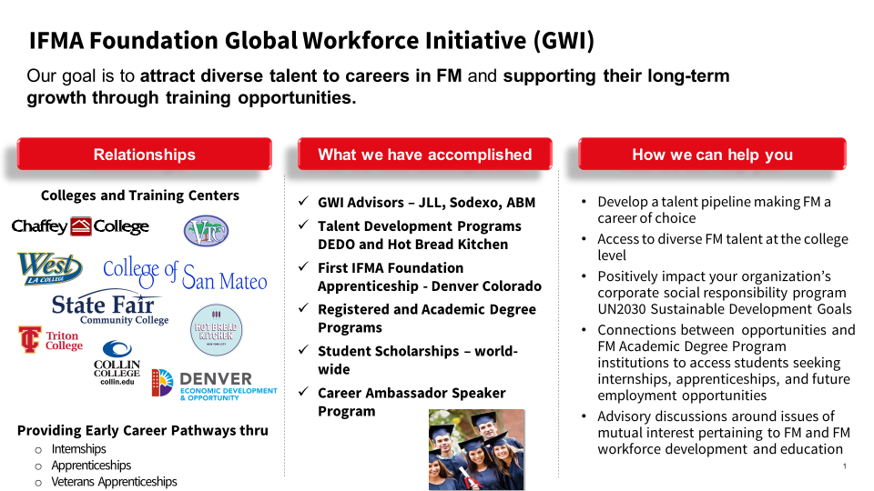

Slide 9
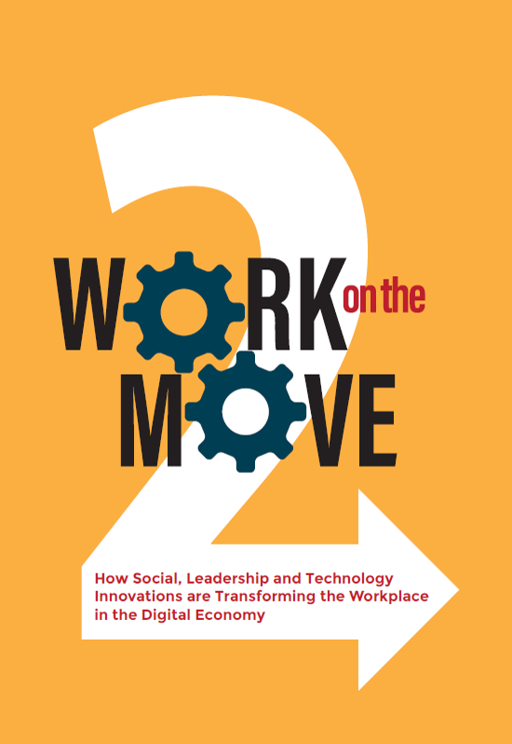

Win Free E-Copies

Slide 10
What is the average age of a facility manager?
27
49
57

Slide 11
What percentage of facilities manager will be retiring in the next 5 years?
7%
16%
50%

Slide 12
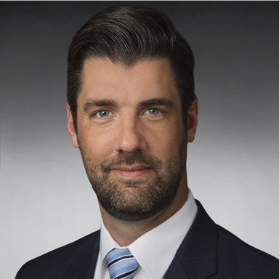
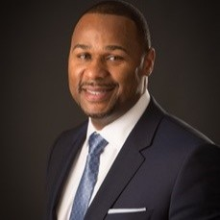
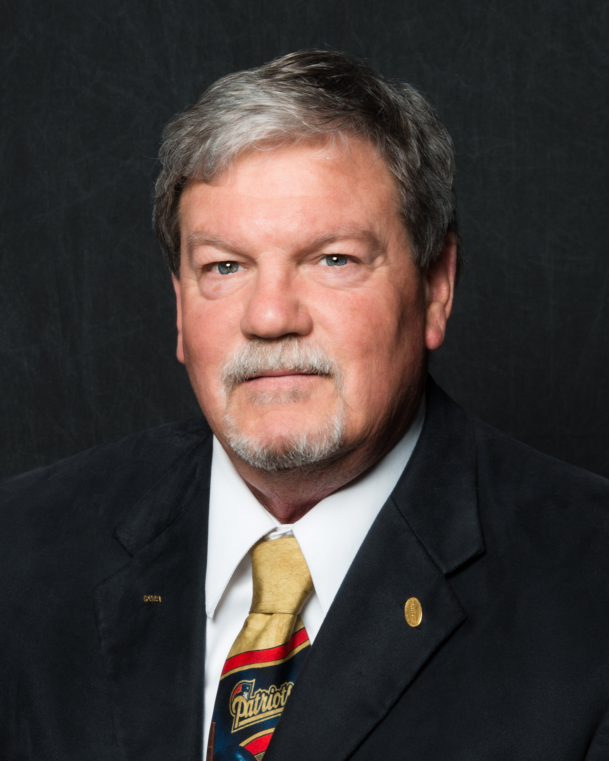
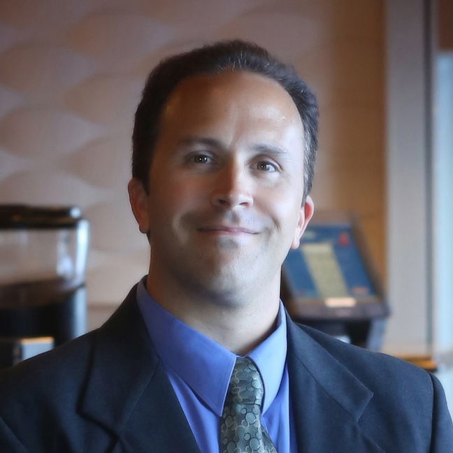
Meet Our Panelists
Edward Connolly
Managing Director, JLL Consulting
Moderator – Holly Rau
Managing Director, PeopleSpace
IFMA WE So Cal Leader
Raymond Hall
Head of HR, North America, JLL
Bill Conley
National Manager, Facility Services, Yamaha Motor Corporation
Kevin Reelfs
Program Integration & Strategy Lead, Leidos

Slide 13
How are you currently working?
100% remote – working from home
At the office full-time
A hybrid of remote and at the office

Slide 14
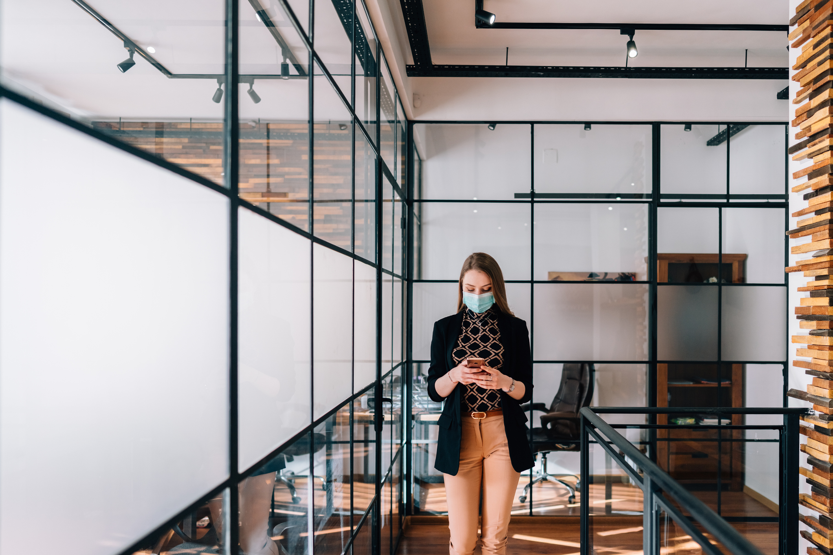
What are industries doing around re-entry from the pandemic?

Slide 15
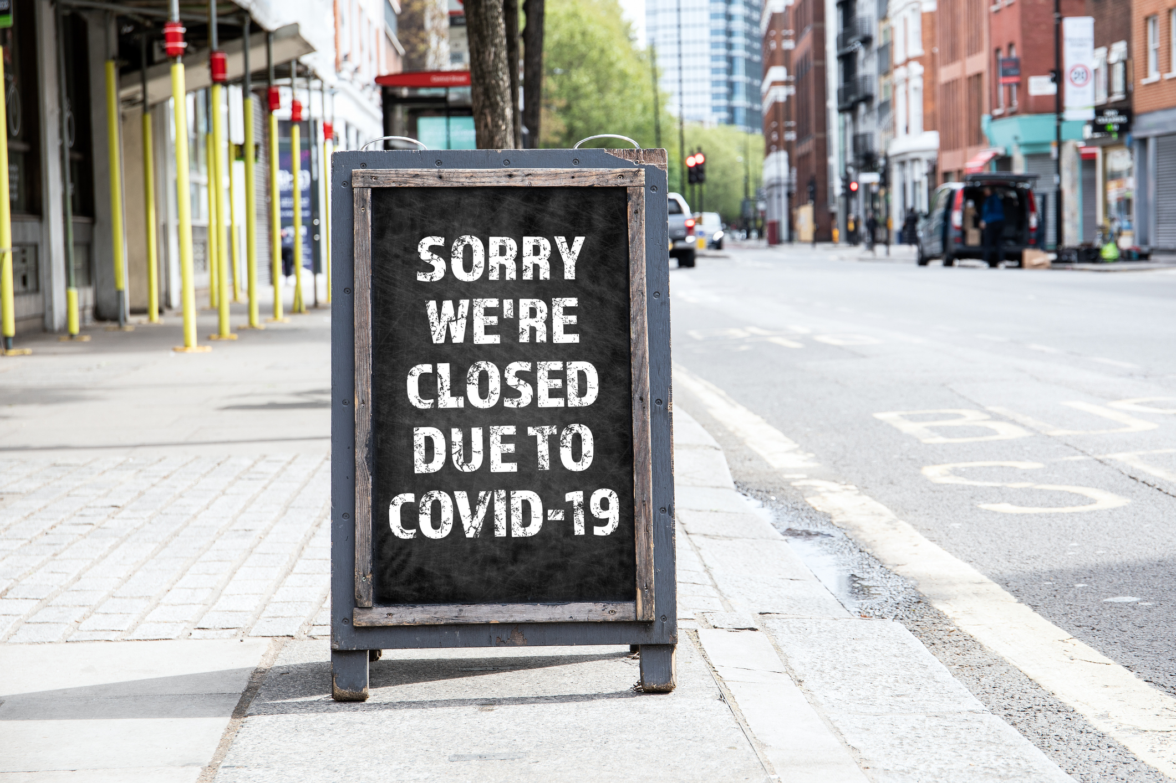
What are the impacts on commercial real estate?

Slide 16

Has remote work impacted creativity/innovation? Employee well-being?

Slide 17

What are new concepts in space design you’re seeing?

Slide 18
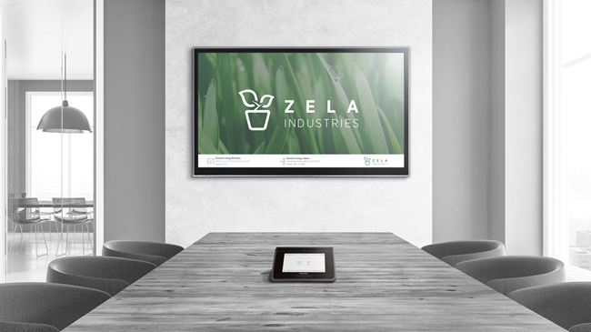
How is technology impacting this evolving workplace?

Slide 19
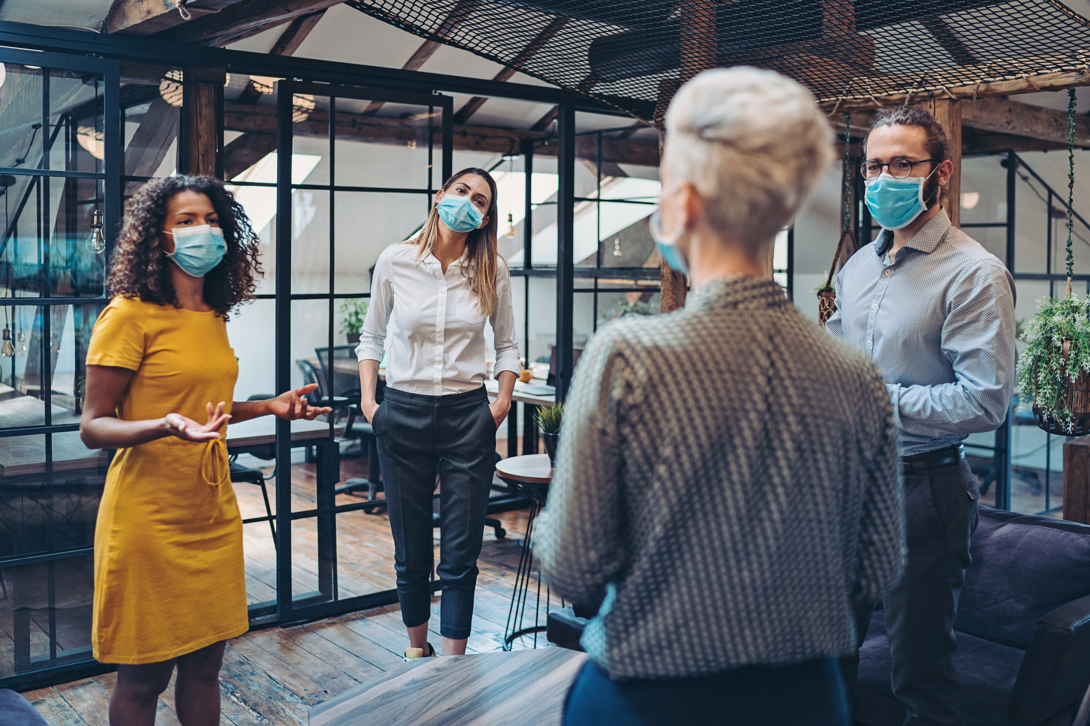
Does your organization have specific examples of internal departments working together?

Slide 20
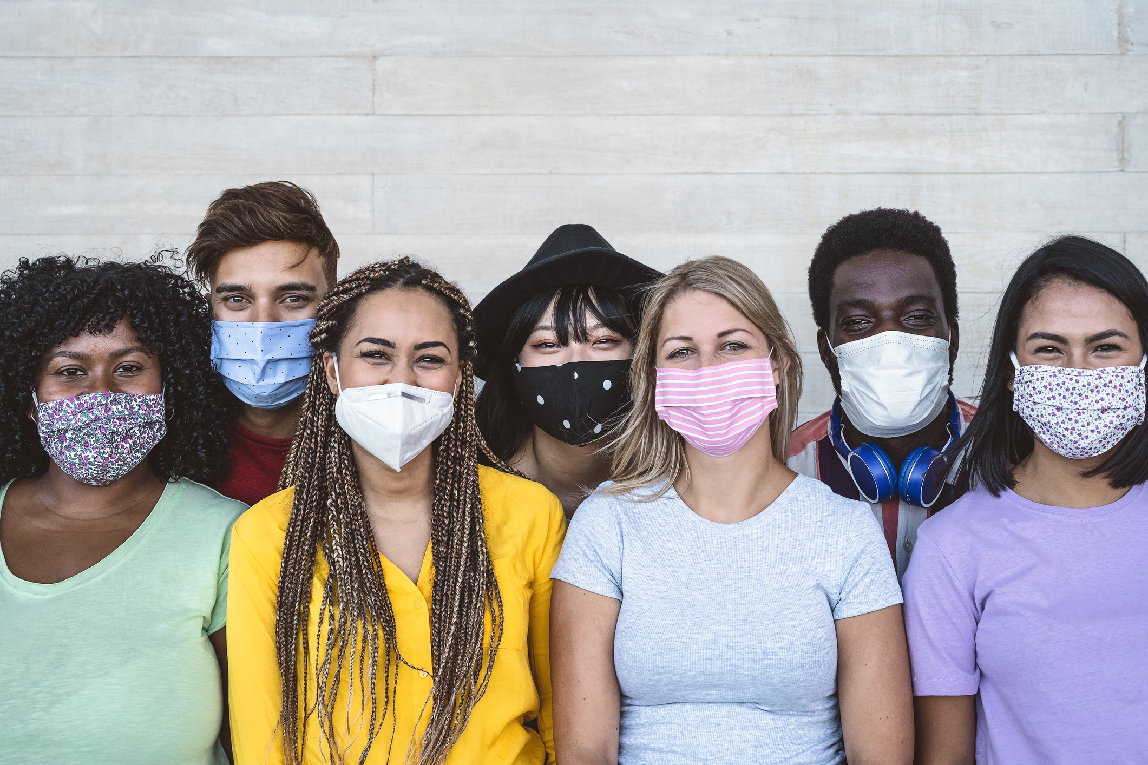
How has COVID impacted diversity and inclusion in the workplace?

Slide 21
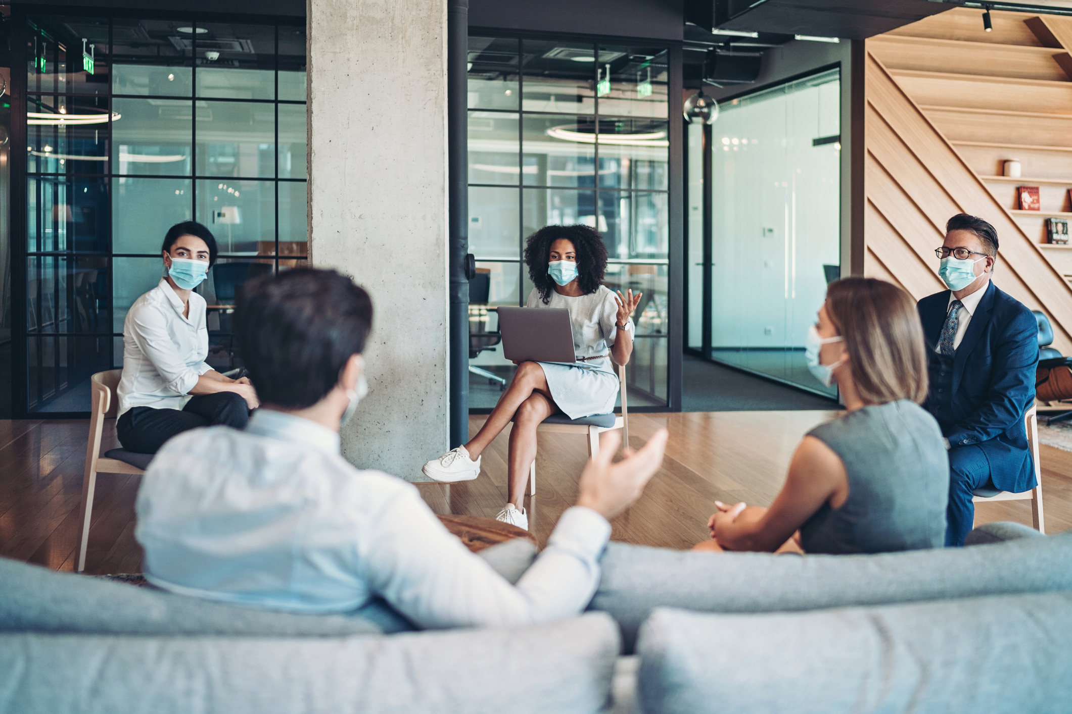
What benchmarking has been done to better understand what types of organizations are thriving in remote environments vs the traditional office?

Slide 22
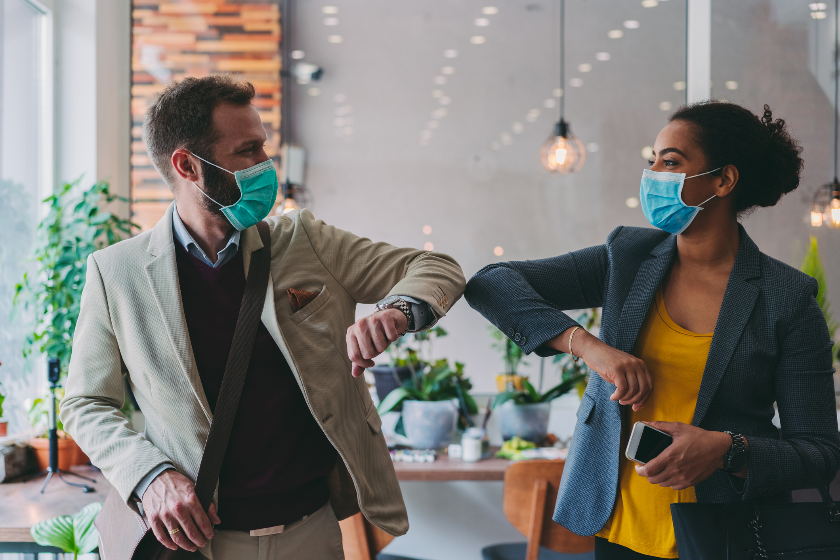
What can we do to prepare for the future to transform our workplace from a sustainability and health/wellbeing standpoint?

Slide 23
How are you planning to continue to work post-pandemic?
100% remote – working from home
At the office full-time
A hybrid of remote and at the office

Slide 24
Questions?

Slide 25
Win Free E-Copies

Slide 26
POST EVENT RESOURCES
Event Video Recording On Demand
ClearTech E-book – Stop Guessing and Start Planning: How Technology Will Unite Us in the Distanced Future
IFMA Foundation - IFMA Foundation Pandemic Manual
JLL – Reimagine, The New Future of Work to Shape a Better World

Slide 27
Contact Information
IFMA ifma.org
IFMA WE we.ifma.org
ClearTech cleartechav.com
ENV env-team.com
People Space peoplespace.com
JLL us.jll.com

